Slide 1

Burp Suite 101
Getting Started with Burp Suite

Slide 2
$ whoami
$ cd ~ && touch about_me.txt
$ echo “I am 0xdaro.” >> about_me.txt
$ cat <<EOF >> about_me.txt
I am not a pro hacker. I am just a web developer who loves Cybersecurity.
EOF

Slide 3
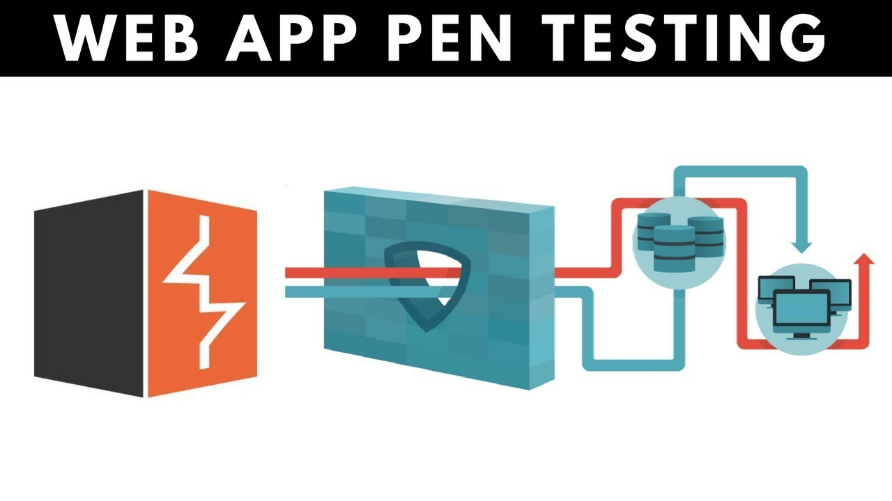

What is Burp Suite?
integrated platform for performing security testing of web applications written in Java

Slide 4

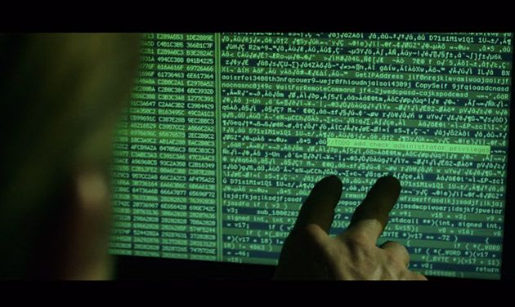
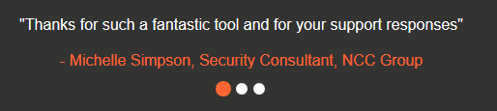


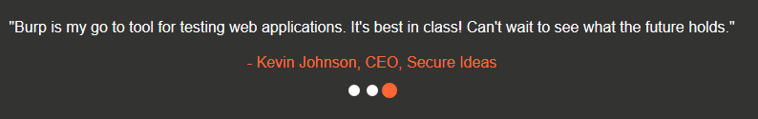
Why do we use Burp Suite?
Famous tool used by Bug Bounty Hunters,
Web Penetration Testers, Security Researchers and Hobbyists.
Many resources on the internet

Slide 5


Burp Suite Pro
Burp Suite Community
Web vulnerability scanner
Advanced manual tools
Essential manual tools
$399 per user, per year
Essential manual tools
Free to use

Slide 6






Running Burp Suite
https://portswigger.net/burp
https://www.oracle.com/java
https://openjdk.java.net
https://www.jython.org

Slide 7
Burp Tools
Target Sequencer
Proxy Mobile Assistant
Scanner (Pro only) Collaborator client (Pro only)
Intruder
Repeater
Decoder
Comparer
Extender

Slide 8
Burp Tools
Target - This tool contains detailed information about your target applications, and lets you drive the process of testing for vulnerabilities.
Proxy - This is an intercepting web proxy that operates as a man-in-the-middle between the end browser and the target web application. It lets you intercept, inspect and modify the raw traffic passing in both directions.

Slide 9
Burp Tools
Scanner - This is an advanced web vulnerability scanner, which can automatically crawl content and audit for numerous types of vulnerabilities.
Intruder - This is a powerful tool for carrying out automated customized attacks against web applications. It is highly configurable and can be used to perform a wide range of tasks to make your testing faster and more effective.

Slide 10
Burp Tools
Repeater - This is a tool for manually manipulating and reissuing individual HTTP requests, and analyzing the application's responses.
Sequencer - This is a sophisticated tool for analyzing the quality of randomness in an application's session tokens or other important data items that are intended to be unpredictable.

Slide 11
Burp Tools
Decoder - This is a useful tool for performing manual or intelligent decoding and encoding of application data.
Comparer - This is a handy utility for performing a visual "diff" between any two items of data, such as pairs of similar HTTP messages.

Slide 12
Burp Tools
Extender - This lets you load Burp extensions, to extend Burp's functionality using your own or third-party code.
Clickbandit - This is a tool for generating Clickjacking attacks.
Collaborator client - This is a tool for making use of Burp Collaborator during manual testing.
Mobile Assistant - This is a tool to facilitate testing of mobile apps with Burp Suite.

Slide 13


Bonus
Free, online web security training from the creators of Burp Suite
https://portswigger.net/web-security
OWASP ZAP
Burp suite alternative
https://owasp.org/www-project-zap

Slide 14
THANK YOU

